Slide 1
SS ZG 526: Distributed Computing
Distributed Mutual Exclusion (DME)
Chittaranjan Hota
Professor, Dept. of Computer Sc. & Information Systems
BITS, Pilani Hyderabad Campus, Hyderabad
hota@hyderabad.bits-pilani.ac.in

Slide 2
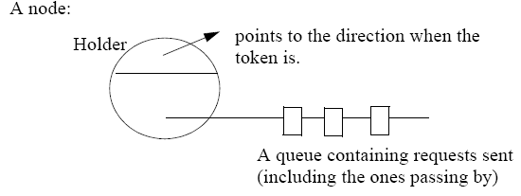
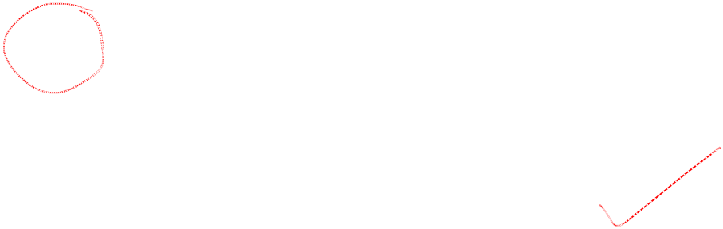
Raymonds’ Tree Based Algo
where the
Birla Institute of Technology and Science, Pilani (Deemed University)

Slide 3

The Algorithm
Requesting the critical section.
1. When a site wants to enter into the CS, it sends a REQUEST message to the node along the directed path to the root, provided it does not hold the token and it’s request_q is empty. It then adds it to it’s request_q.
2. When a site on the path receives this message, it places the REQUEST in it’s request_q and sends a REQUEST message along the directed path to the root provided it has not sent out a REQUEST message on its outgoing edge.
3. When the root site receives a REQUEST message, it sends the token to the site from which it received the REQUEST message and sets it’s holder variable to point at that site.
4. When the site receives the token, it deletes the top entry from its request_q, sends the token to the site indicated in this entry, and sets its holder variable to point at that site. If the request_q is nonempty at this point, then the site sends a REQUEST message to the site which is pointed at by holder variable.
Birla Institute of Technology and Science, Pilani (Deemed University)

Slide 4
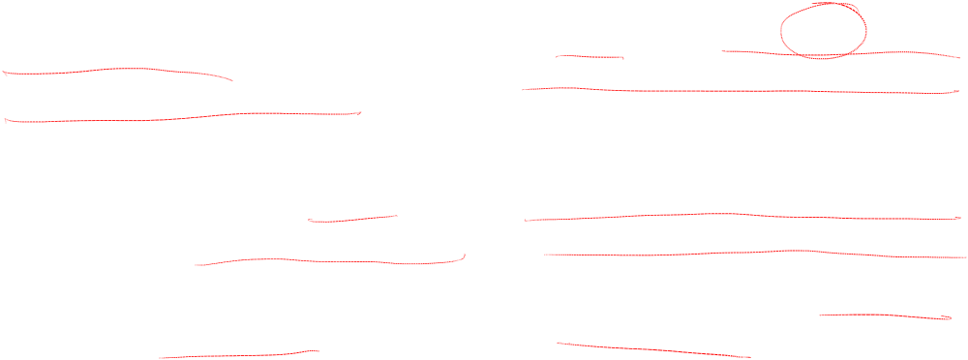
Continued…
Executing the critical section
1. A site enters the CS when it receives the token and its own entry is at the top of its request_q. In this case, the site deletes the top entry from it’s request_q and enters the CS.
Releasing the critical section
1. If its’ request_q is nonempty, then it deletes the top entry from it’s request_q, sends the token to that site, and sets its holder variable to point at that site.
2. If the request_q is nonempty at this point, then the site sends a REQUEST message to the site which is pointed at by the holder variable.
Birla Institute of Technology and Science, Pilani (Deemed University)

Slide 5
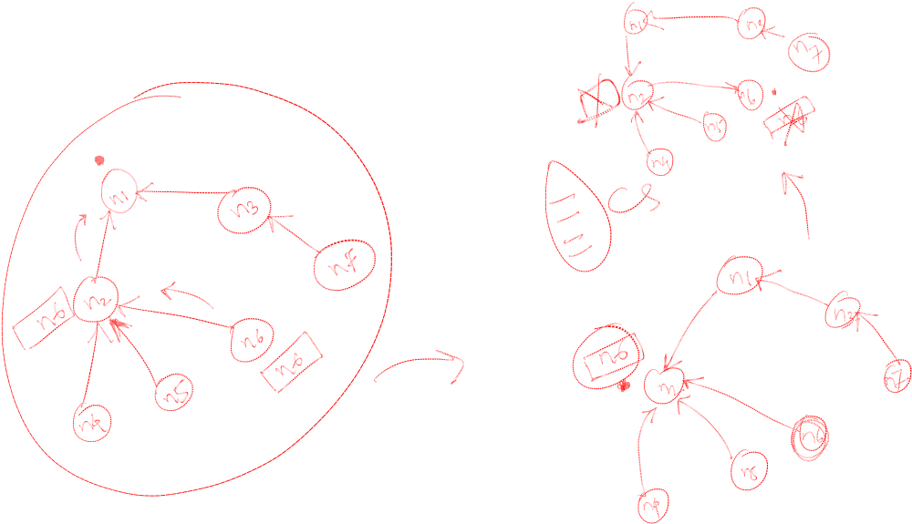
Example1
Birla Institute of Technology and Science, Pilani (Deemed University)

Slide 6
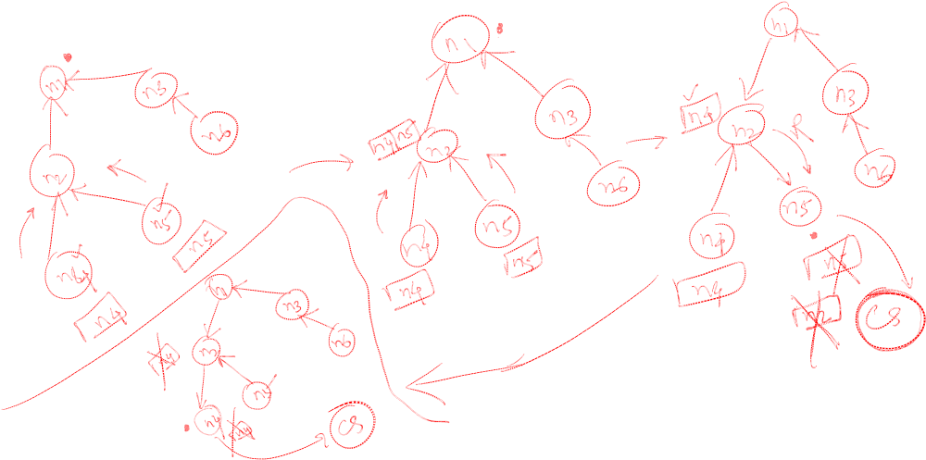
Example2
Birla Institute of Technology and Science, Pilani (Deemed University)

Slide 7
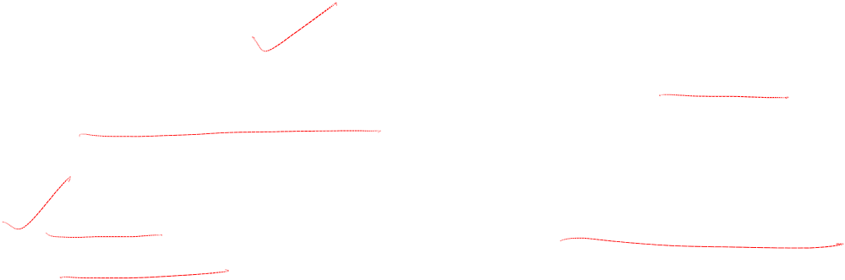
Analysis
Proof of Correctness
  Mutex is trivial.
  Finite waiting: all the requests in the system form a FIFO queue and the
  token is passed in that order.
Performance
  O(logN) messages per CS invocation. (Average distance between two
  nodes in a tree)
Birla Institute of Technology and Science, Pilani (Deemed University)

Slide 8
Next module
Deadlock detection in distributed systems
Birla Institute of Technology and Science, Pilani (Deemed University)

